Slide 1
Welcome, Parents!
Mr. Andrew Hughart
Grade 2
Room 206

Slide 2
Classroom Schedule
12:30-1:00 | Lunch
M, T, W, Th | Recess
Mondays | Library
Tuesdays | Art and Computer
Wednesdays | Music
Thursdays | Computer and Language and Literacy
Fridays | Gym * Alternate weeks Music
 | * Once a month we will have 2 gym classes
This is our weekly schedule!

Slide 3
Get to Know Me
My experience
My background
I’ve been teaching for 20+ years.
I taught Kindergarten ,first and second grades
Previously taught at PS21 Bronx, NY and Six To Six Magnet School, Bridgeport, CT
I grew up in Westchester County New York
I achieved a AS Business Administration, Westchester Community College, BBA Entrepreneurship, Pace University
MS and 6th Year Elementary Education, Bridgeport, CT
Professional Certificate and Mentor teacher

Slide 4
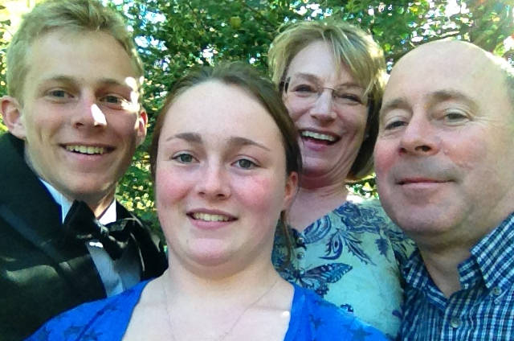
My Family
My spouse/partner
Our children
Our pets

Slide 5
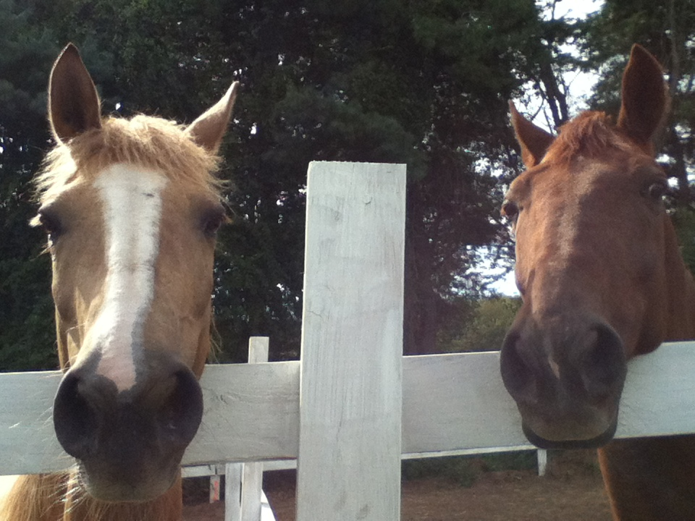
Hobbies/Interests
READING
Writing
Furniture refinishing/ seat weaving
Hiking
THE BEACH!!!
Horse Rescue
Music

Slide 6
Communication
My email: ahughart@bridgeportedu.net
My phone:203 576 7807
Class web site:
Absence excuse notes
Change in dismissal plan notes

Slide 7
Class Expectations
Classroom rules posted
Work Habits: work quietly, independently and responsibly
Incomplete work
Learn in Whole group, small group and individual settings
Homework and Behavior chart (Red, Yellow and Green)
I expect families to sign and return daily
Friday rewards

Slide 8
Classroom Grading Policy
POWERSCHOOL: check often
Math: Tests: 50%, Classwork 25% Centers 25%
Reading: Classwork 25%, Tests 50%, Centers 25%
Science and Social Studies: Notebooks 50%, Classwork 50%
Writing: Classwork 50%, Writing Prompts 50%
Work habits also influence grades
Homework: Completed or not completed grades 0,1,2
Behavior charted through homework/behavior chart

Slide 9
Class Programs
Reading and Writing: Journeys
Math: Math In Focus
Science and Technology: Fusion
Social Studies: Common Core standards
Assessments
DRA, Chapter/unit tests/ benchmarks
Aimsweb,

Slide 10
Reading
Reading to, with and by your child is the most important activity you can do to promote success!
Classroom library will be available
Monthly reading log provided (on Class website as well)
Gold Medal Readers
Gold Medal: 20 minutes per day for 165 days.
Silver Medal: 20 Minutes per day for 145 days.
Bronze Medal: 20 minutes per day 135 days.

Slide 11
Writing
Personal Narratives
Poetry
Letters to describe, persuade
Nonfiction
Paragraphs

Slide 12
Math
Deepening Addition and Subtraction Fact Strategies
Place Value, Money and Time
Geometric Shapes 2D and 3D
Using Strategies To Add And Subtract
Estimating and Measuring Length
Sorting, Classifying and Representing Data
Addition and Subtraction to 1,000

Slide 13
Math Problem Solving Strategies
Make sense of problems and persevere in solving them
Use numbers and words to help make sense of problems
Explain thinking and respond to the thinking of others
Recognize math in every day life and use knowledge to solve problems
Use appropriate tools strategically
Be precise when solving problems
Be clear when sharing ideas

Slide 14
Science and Technology
Science Fusion
Topics
Work Like A Scientist
Technology
Plants and Animals
Environments
Earth and Its Resources
Weather
Solar System

Slide 15
Classroom Volunteer Opportunities
Photocopying
Class Trip Coordination
Friday Clean ups
Classroom library
Spelling city management

Slide 16
Homework
20 minutes of homework every night. (spelling and math paper)
Read 20 minutes every day!!!
Xtramath.com
Spellingcity.com

Slide 17
Attendance
School is important!
Students enter the building at 8:35
Class starts at 8:50
Plan Ahead: for early dismissals
Notes to excuse absences

Slide 18
Supplies
Bring these items each day
Don’t bring these items
2 Number 2 Pencil
Homework/Behavior chart signed by parent!!
Electronic Devices
Toys
Birthday Invitations

Slide 19
Communication
Written notes to excuse absences
Write notes for change of dismissal plans. (blanket note for early dismissal days)
Email: ahughart@bridgeportedu.net (not time sensitive issues)
Check Powerschool and Classroom website

Slide 20
Specialists

Slide 21
Art
Mrs. Polizzo
Students will explore the elements and principles of art using a variety of media
Students will study art history and art vocabulary
Most students have art once a week
6th grade has art twice a week
Grade is based on effort, following directions, behavior and creativity

Slide 22
Computers Ms. Blaszczynski – Room 211
Students have class twice a week.
Students will learn how to use computers through educational software and websites.
They will also learn
Microsoft Paint, Microsoft Word, Microsoft PowerPoint
Computer Parts, Keyboarding, Internet Safety
It is a Pass/Fail class, but marks are given for Conduct/Effort
Please sign up for Class Dojo so you can see how your student does in Computer class.
Every class a student will be chosen as the “Star” student and be given a sticker.

Slide 23
PHYSICAL eDUCATION
Mr. Tvardzik
Mr. Bonaventura
Mr. Whalen
Through the traditional Physical Education curriculum, along with the Adventure-Based Learning curriculum, and swimming, the goal of the Physical Education Department is to promote a fun and safe learning environment that will enhance students' fitness levels and promote a physically active and healthy lifestyle that will lead to lifelong fitness and health.
Information
Students must come prepared to class with appropriate footwear (sneakers). If your child is in 7th or 8th grade they must come to class with a change of clothes (sneakers, shorts/sweatpants, and a t-shirt. Uniform colors are acceptable)
7th and 8th students are encouraged to bring a lock to secure all their belongings so nothing goes missing in the locker rooms.
If a student is unable to participate in PE, we must receive a written note from the parent or a doctor so he/she can be excused. One copy should be given to the PE teacher and another copy should be on file with the school nurse
More information to follow regarding swimming

Slide 24
Questions?

Slide 25
Art Mrs. Polizzo Students will explore the elements and principles of art using a variety of media Students will study art history and art vocabulary Most students have art once a week 6th grade has art twice a week Grade is based on effort, following directions, behavior and creativity

Slide 26
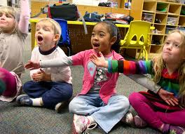
Music
Miss Boden, HARTT school of music
Undergraduate 2004 - 2008, Graduate 2008 - current
Bridgeport teacher at High Horizons Magnet 6 years
General Music Grades K – 4
Singing in pitch
Percussion, Orff instruments, and recorder
Moving in organized dances or expressively
Learning and using music vocabulary
Experiencing and performing music of other cultures
Performing in a musical environment
Assembly at 1:15 PM on Thursday, December 11th in the gym
CONCERT at 6 PM on THURSDAY, MAY 28th

Slide 27
Let’s Have a Great Year!

